Slide 1
Vector Space Model, Bag of Words & TF-IDF
Ahmad Fathan Hidayatullah, S.T., M.Cs.

Slide 2
Intro
Everything is a vector in some high-dimensional space
(words, documents, queries, user preferences)
Issues to consider: – What are the dimensional of that space (basic vector)? – How to project words/docs/queries to that space? – How to compare documents and queries?

Slide 3
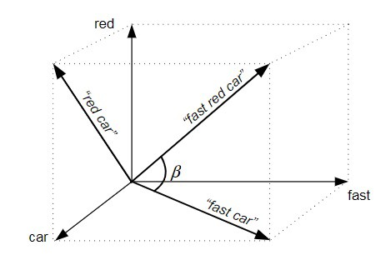
Vector Space Model
Vector Space Model is a multidimensional representation of words in a continuous vector space.
The words closely or semantically related to each other tend to be nearer to each other in the model.
A vector space model is involving two steps, in first step we represent the text documents into vector of words and in second step we transform to numerical format.
VSM sample visualization. Source: Polyvyanny & Kuropka, 2009

Slide 4
The Two Models
There are two models that can be used to “convert” words into vectors:
Count-based model — a computation model that relies on the frequency of words within a document.
Predictive model — a model that aims to predict the context or the target word based on the neighboring terms.

Slide 5
What is VSM used for?
Information filtering
Information retrieval
Indexing
Relevancy rankings

Slide 6
Bag-of-Words (BoW) Model
The bag-of-words model (BoW) is a vectorization technique that uses the number of occurrences of words within a document or a corpus, which is essentially defined as the dataset of known words.

Slide 7
Bag-of-Words (BoW): Example
Take the set of documents below as examples.
“I am the king.”
“The kingdom is prosperous.”
“She is the queen.”
“The royal queen is beautiful.”
Applying BoW to the set, we will get a table below:
 | I | am | the | king | kingdom | is | prosperous | she | queen | royal | beautiful
Doc 1 | 1 | 1 | 1 | 1 | 0 | 0 | 0 | 0 | 0 | 0 | 0
Doc 2 | 0 | 0 | 1 | 0 | 1 | 1 | 1 | 0 | 0 | 0 | 0
Doc 3 | 0 | 0 | 1 | 0 | 0 | 1 | 0 | 1 | 1 | 0 | 0
Doc 4 | 0 | 0 | 1 | 0 | 0 | 1 | 0 | 0 | 1 | 1 | 1

Slide 8
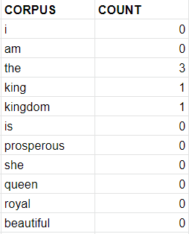
Bag-of-Words (BoW): Example
To transform a sample text into a vector using BoW, each occurrence of the corpus words in the sample text is counted, and is outputted as an array of integer counts with size same as the corpus.
For example, the sample text “The king and the queen rule the kingdom” will have a vector representation of:
[ 0, 0, 3, 1, 1, 0, 0, 0, 0, 0, 0 ]

Slide 9
Term Frequency-Inverse Document Frequency (TF-IDF)
The TF-IDF, an advanced variant of BoW, takes into account the importance of the words based on its rarity in the document.
However, instead of vectors with discrete counts like BoW, the converted vector now contain continuous in value.

Slide 10
TF-IDF
TF-IDF weight is a statistical measure used to evaluate how important a word is to a document in a collection or corpus.
The importance increases proportionally to the number of times a word appears in the document but is offset by the frequency of the word in the corpus.

Slide 11

Term Frequency (TF): is a scoring of the frequency of the word in the current document. Since every document is different in length, it is possible that a term would appear much more times in long documents than shorter ones. The term frequency is often divided by the document length to normalize.

Slide 12

Inverse Document Frequency (IDF): is a scoring of how rare the word is across documents. IDF is a measure of how rare a term is. Rarer the term, more is the IDF score.

Slide 13
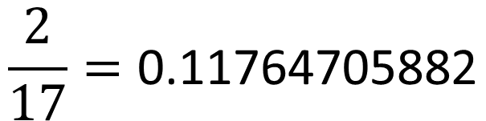
So, suppose we have a document with a length of 17 words and a target term ‘queen’. If ‘queen’ appeared in the document 2 times, the TF weight of ‘king’ would be:
$$\frac{2}{17}=\text{0.11764705882}$$

Slide 14
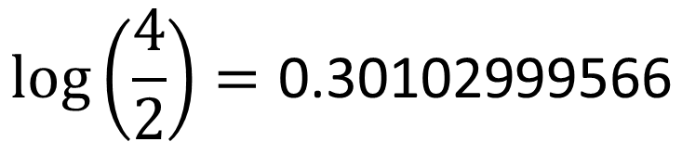
If the term ‘queen’ appeared in 2 documents out of 4 dataset, the IDF weight would be:
$$\log\left(\frac{4}{2}\right)=\text{0.30102999566}$$

Slide 15

Finally, the TF-IDF weight of the term ‘queen’ is
Tf-idf = tf*idf = $\text{0.11764705882}\text{*}\text{0.30102999566}$
= 0.0354152936

